Slide 1
BACKEND

Slide 2



Slide 3
OVERVIEW

Slide 4
OVERVIEW
What is server-side development.
PHP language fundamentals.
Node language fundamentals.
Using Node to create REST API with CRUD functionality.
Using Node with WebSockets to create push-based functionality.
Serverless computing.
Creating an API from scratch.

Slide 5
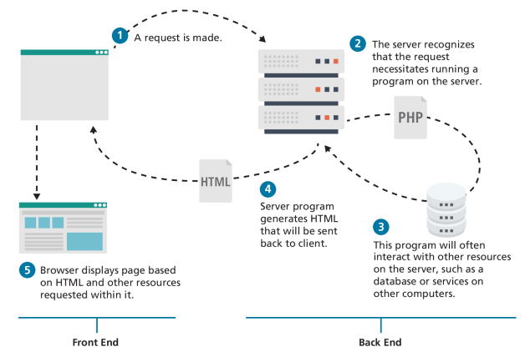
BACKGROUND
Backend development can also be called server-side development or API (Application Programming Interface) development.
Server side technologies are used to access data, handle security, and allow websites to interact with external services such as payment systems.

Slide 6
COMMON SERVER-SIDE TECHNOLOGIES
ASP – Microsoft’s first server-side technology
ASP.NET – Replaced Microsoft’s ASP technology
.NET / .NET Core – Modern Microsoft server technologies
JSP(Java Server Pages) – Similar to ASP.NET only it uses Java instead of C# and is integrated in the J2EE environment.
Perl – Used mainly for manipulation of texts.
PHP – PHP was one of the first JavaScript based server languages.
Node.js – Came out after PHP and is also JavaScript based.
Python – Flexible language used for a wide range of applications.
Ruby – Flexible language used for a wide range of applications.

Slide 7
APIS

Slide 8
BACKGROUND
APIs or application programming interfaces are a core concept of backend full-stack development and these APIs are usually located on server side scripts like on a node .js file.
They are means of communication between 2 computers, it could be a client or a server, or to a JSON on the internet.

Slide 9
ENDPOINTS
Endpoints are fundamental elements of APIs, they are the connection points between computers, for instance, http://localhost:8080/tshirt would be an endpoint, it connects to a location on a network.

Slide 10
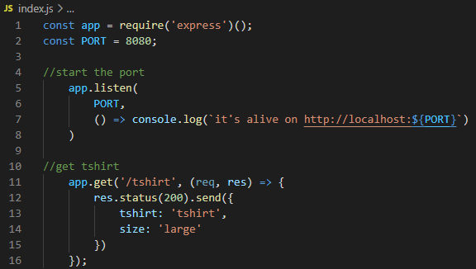
API ARGUMENTS
APIs usually include a req and res argument. The req is what is received from the client, and the res is what is sent back to the client.

Slide 11
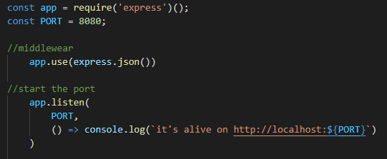
MIDDLEWEAR
Middlewear is script that runs before API calls are executed.
For example, on the screenshot shown, the middlewear expresss.json() is used to convert all bodies into JSON objects.
Another example for middlewear would be to authenticate, so that an API request gets authenticated before running (app.use(auth)).

Slide 12
EXAMPLE CONSOLE LOGS
Make sure that node and npm is installed on your computer.
Create a new blank visual code project.
Type npm init –y (used to create package.json files)
Type npm install express (used for api syntax)
Type npm install nodemon (used for re-running app when file changes are saved)
Type npm install mongoose (used for db connection)
Type npm install dotenv (used for environment variable)
On the package file, change “start” to “nodemon app.js”
Create a new index.js.

Slide 13
INDEX.JS
Type the lines on the screenshot to the index.js file.
The app.listen() method is used to open the port on the local server localhost:8080. When the app is deployed on the internet, a database connection string on the cloud will replace the localhost:8080 and it will no longer be hosted on your local computer, it will be hosted on the internet.
The app.get() is used to return an object of tshirt and size whenever the URL is defined as /tshirt.

Slide 14
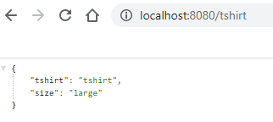
BROWSER OUTPUT
To test this code, type localhost:8080/tshirt on the browser and the result of the tshirt object should return.
If it doesn’t work, the browser will display can not get.

Slide 15

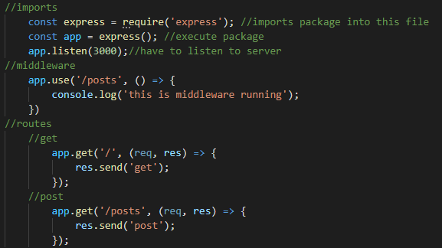
EXAMPLE WITHOUT DATABASE

Slide 16
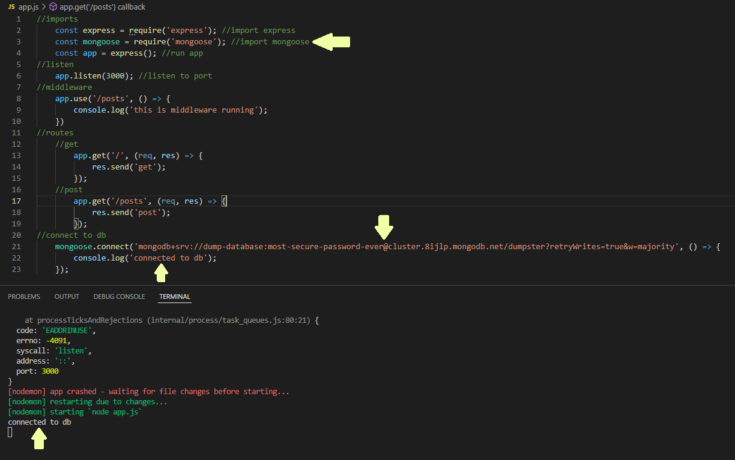
EXAMPLE WITH DATABASE

Slide 17
PHP

Slide 18
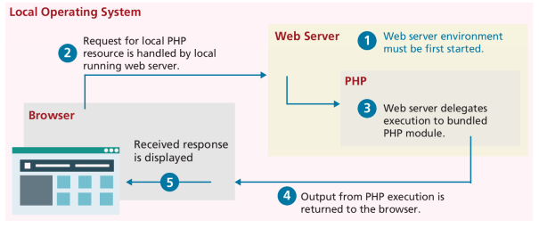
INTRODUCTION
PHP is a dynamically typed language that provides class and functions in a way consistent with OOP such as C++, C#, and Java.
Syntax for loops, conditionals, and assignments are identical to JavaScript. Only differing when you get to functions, classes, and variable assignments.
PHP is often installed with Apache and MySQL.

Slide 19
TAGS AND COMMENTS
PHP files are saved with the .php extension.
Code must be wrapped within an opening <?php tag and a closing ?> tag. Code inside those tags are interpreted and executed while code outside are echoed (displayed) ‘as is’ to the client. For this reason, it’s very common for PHP files to have HTML markup.
Comments in PHP are the same as in JavaScript, using /* */ and //.

Slide 20
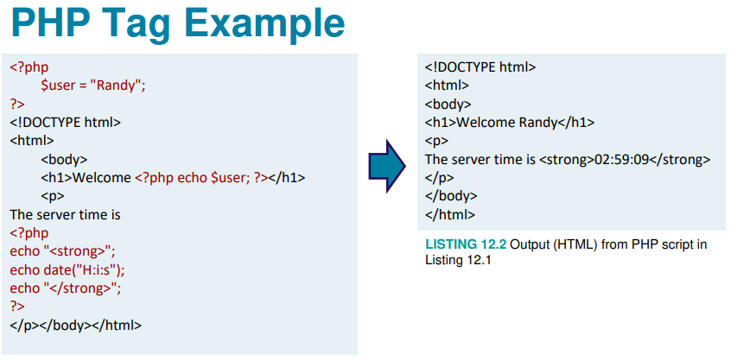
EXAMPLE

Slide 21
VARIABLES AND DATA TYPES
Variables in PHP are dynamically typed, meaning their type is unknown until the app runs.
They’re also loosely typed, because different data types can be assigned to them over time.
Typical data types might include booleans, integers, floats, strings, arrays, and objects.

Slide 22
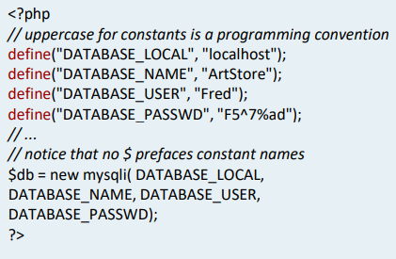
CONSTANTS
Constants can be defined using the define() syntax.

Slide 23
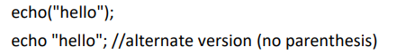
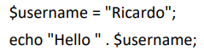
ECHO()
Echo() is a function used to output data to the screen.
Strings can be concatenated using the period char.

Slide 24
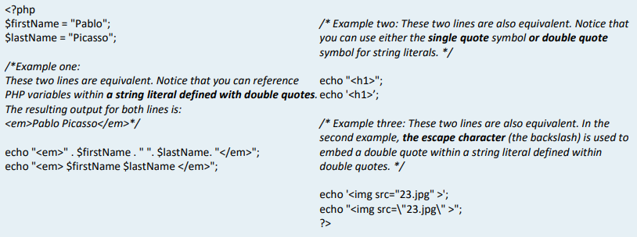
EXAMPLES

Slide 25
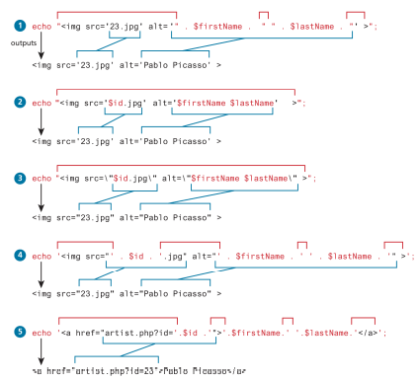
EXAMPLES

Slide 26
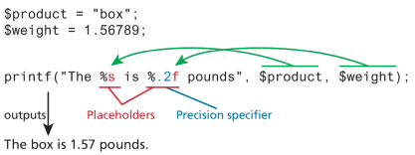
PRINTF()
Printf() is another method to output data to the screen.
The main difference is that printf() has a return value while echo() does not.

Slide 27
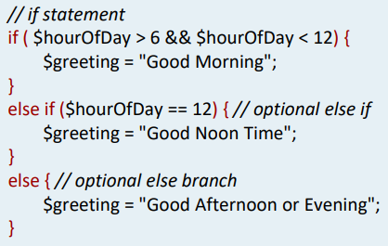
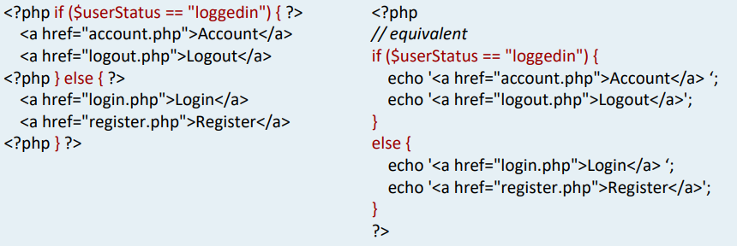
IF-ELSE CONDITIONALS

Slide 28
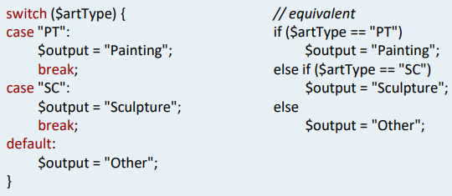
SWITCH CASE CONDITIONALS

Slide 29
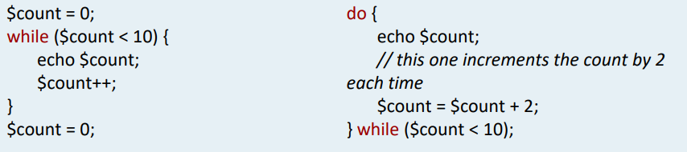
WHILE AND DO-WHILE CONDITIONALS

Slide 30
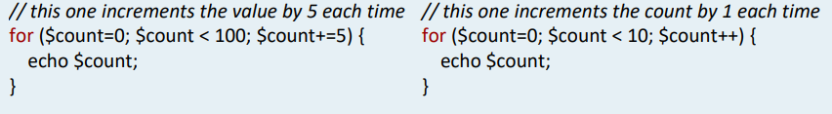
FOR LOOPS

Slide 31
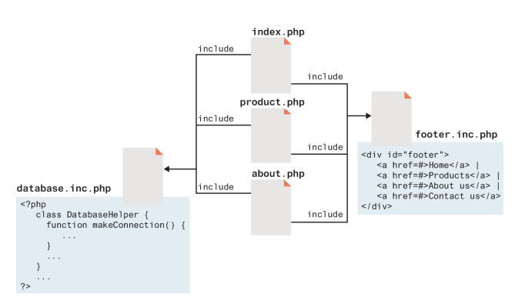
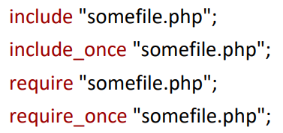
INCLUDING FILES
Files from other locations can be imported as well using the syntax below.

Slide 32
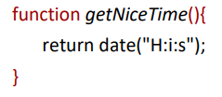
FUNCTIONS
PHP functions are very similar to JavaScript functions.
They require the ‘function’ callout and (){} brackets respectively.

Slide 33
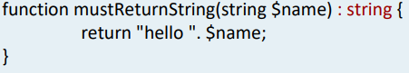
RETURN TYPE DECLARATION
When declaring a function, a return type can be defined explicitly as shown in the syntax below.

Slide 34
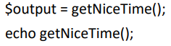
FUNCTION INVOKING
To invoke a function, the following syntax below can be used.

Slide 35
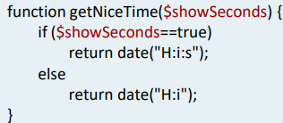
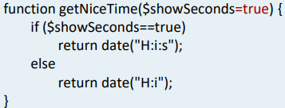
FUNCTION ARGUMENTS
Arguments or parameters can be passed as shown below.
If the parameter doesn’t exist, it can defaulted by adding an equal sign.

Slide 36
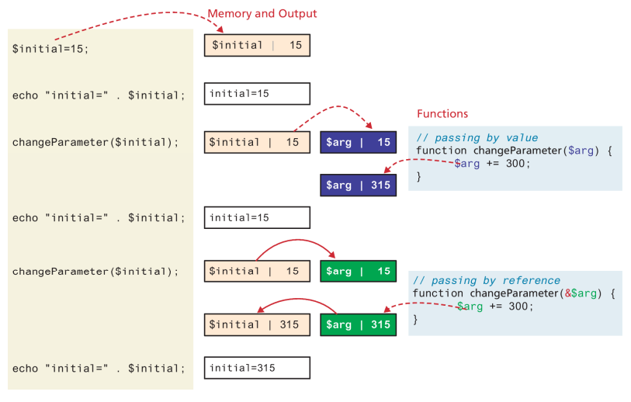
PASSING BY REFERENCE
Passing by reference means to pass a pointer of the value as a param, not the actual value itself.
To pass as a reference, the & symbol needs to be added in front of the variable, similar to C++.

Slide 37
SCOPE
All variables defined within a function have function scope, meaning they are only accessible within a function.
Unlike JavaScript, any variable defined outside a function is not accessible within the function, even if declaring as global.

Slide 38
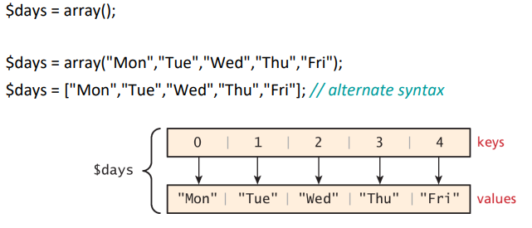
ARRAYS
Arrays are ordered maps in PHP. This means that the first item is not necessarily defined with an index of 0 or even integers.
Array keys are restricted to integers and strings, whereas array values can be any object or type.
Arrays can be declared as shown below.

Slide 39
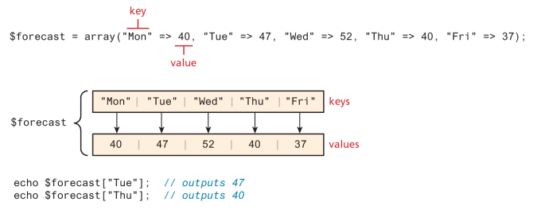
ACCESSING ARRAYS

Slide 40
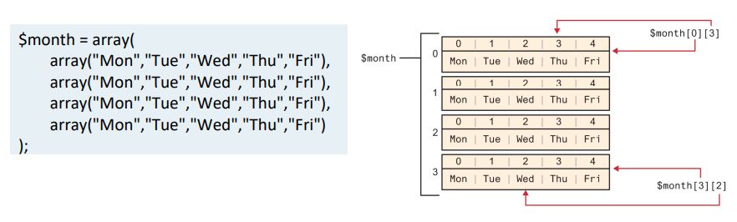
MULTI-DIMENSIONAL ARRAYS

Slide 41
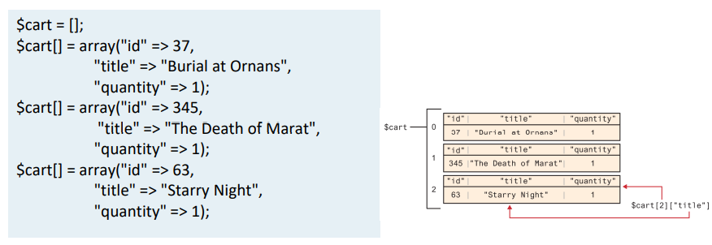
MULTI-DIMENSIONAL ARRAYS

Slide 42
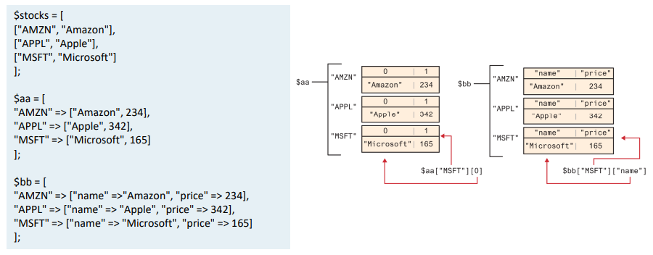
MULTI-DIMENSIONAL ARRAYS

Slide 43
ARRAY ITERATION
PHP arrays are dynamic, meaning they can grow or shrink in size.
To add at a known index, you can use $days[5] = “Sat”;
To add at the end, you can use $days[] = “Sun”;
To check if a value exists, you can use isset().
Array elements can be deleted using the unset() function.

Slide 44
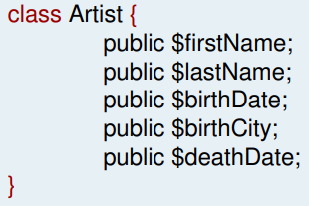
CLASSES
PHP uses OOP with the concept of classes and objects.
Classes can be defined as shown below.

Slide 45
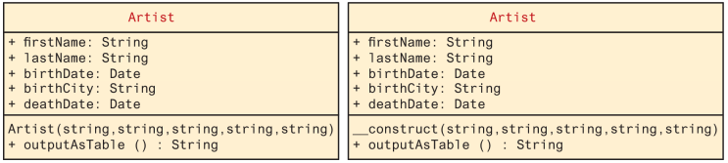
CLASS CONSTRUCT

Slide 46
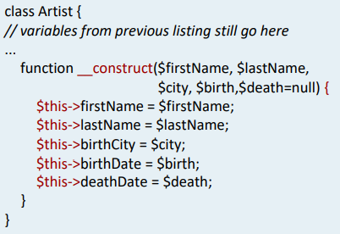
CONSTRUCTORS
Constructors are defined inside the class to define its parameters.
They are initialized with a double underscore __construct().

Slide 47
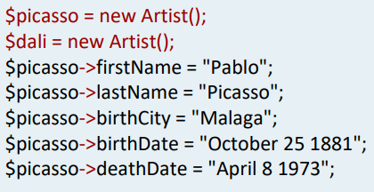
OBJECTS
Objects are instances of classes, and can be defined with $picasso = new Artist(), where properties can be accessed as needed as shown.

Slide 48
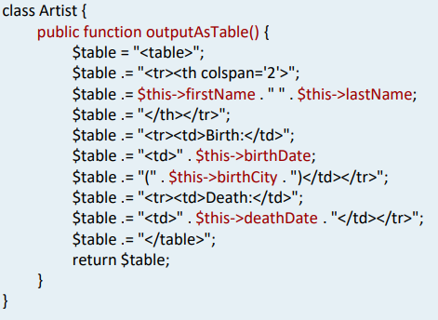
METHODS
Methods are just like functions but usually defined within a class.
Methods can be called in different ways.
$picasso = New Artist(…)
Echo $picasso->outputAsTable()

Slide 49
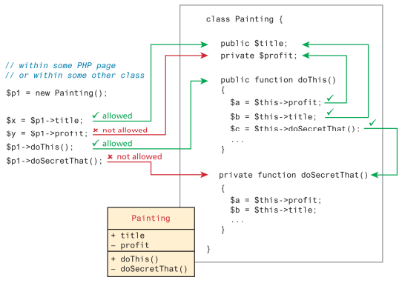
ACCESSIBILITY
Accessibility aka visibility determines how accessible a class member is.
A method can either be public, private, or protected.

Slide 50
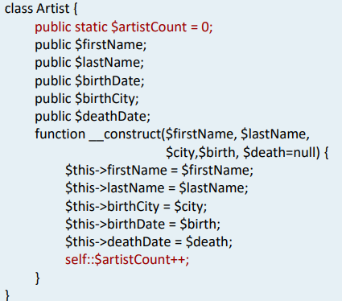
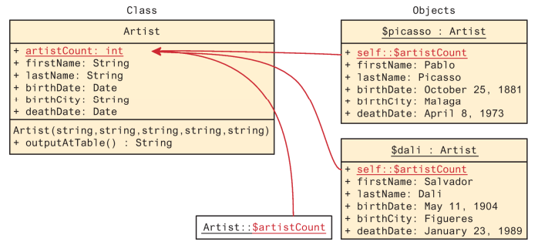
STATIC MEMBERS
Static members are properties that all instances share, meaning all objects will share the same value.

Slide 51
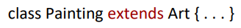
INHERITANCE
Enables you to create new PHP classes that re-use, extend, and modify behavior as defined by other PHP classes.
A class that is inherited from another class is said to be a subclass or a derived class.
A class that is being inherited from is called a superclass.
Inheritance is initialized by using the extend syntax.

Slide 52
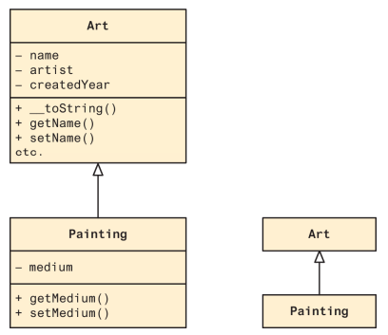
INHERITANCE

Slide 53
NODE

Slide 54
INTRODUCTION
Node is essentially a newer replacement of PHP, it’s a server side language used to send data to the frontend through HTTP requests.
Although PHP is similar to JavaScript, Node 100% uses JavaScript as its language.
Using the same language on the frontend and backend improves developer productivity because of integration, code sharing, and reusability. JavaScript has also become the most popular and widely used language in the world.
Node is used by eBay, Netflix, Mozilla, GoDaddy, Groupon, yahoo, Uber, PayPal, and Linkedin.
Node is commonly preferred for emerging web dev approaches such as microservices, serverless computing, internet of things, and cloud-service integrations.

Slide 55
PROS
Node is very fast which is why it’s preferred over Java and PHP.
It never blocks
Everything is asynchronous so it never waits for an API to return data. This means it never blocks. It takes the next API as it comes.
Great concurrency
Great for quering data
Single-threaded for async processing

Slide 56
CONS
Not suitable for heavy computation.
Does not work well with relational databases.

Slide 57
COMMON NODE LIBRARIES
Express JS – adds helper functions to writing apis
Mongoose – makes it easy to connect to a database

Slide 58
NODE STREAMS
Streams are objects that enable you to read and write data continuously.
There are 4 types of streams, such as readable, writable, duplex, and transform.

Slide 59
NPM
NPM is node package manager, and is often installed with Node.
It is used for managing all the packages and modules of Node.
It provides repositories for node.js packages/modules from search.nodejs.org.
It provides command-line utilities to install those packages.
To use a module, the require() syntax can be used.
To install, update, or delete a dependency, you can use npm install express, npm update, npm uninstall express.

Slide 60
REPL
Read – read the user’s input, parses it into JavaScript.
Eval – takes and evaluates the data structure.
Print – prints the results.
Loop – loop the above command until user presses ctrl-c twice.

Slide 61
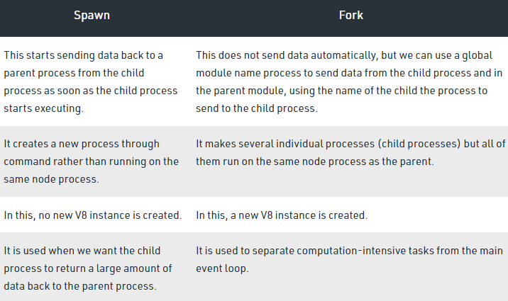
FORK() VS SPAWN()
Fork() and Spawn() both create child processes.
Fork() is a special instance of spawn().
Spawn() is designed to run system commands.

Slide 62
TRIVIA
The buffer class is used to store raw data like an array of integers.
Piping is used to connect the output of one stream to another.

Slide 63
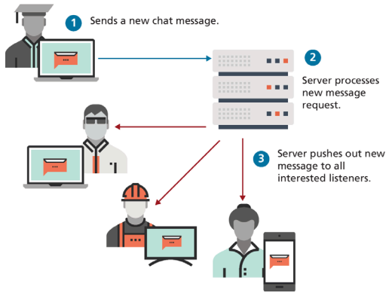
PUSH-BASED ARCHITECTURE
Push-based web applications push information from the server to the client.
An example of this is receiving a phone call, the client phone rings based on a pulse from the server phone.

Slide 64
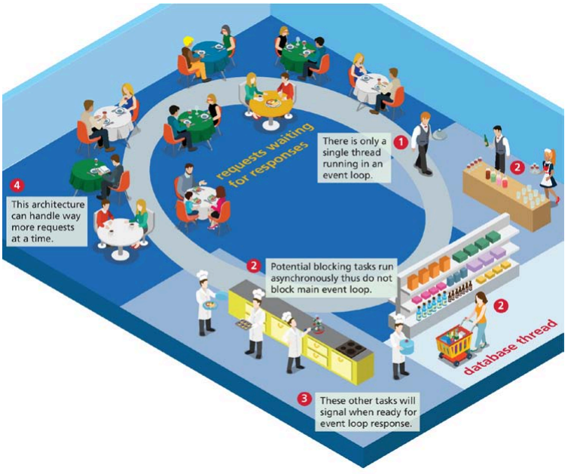
NON-BLOCKING ARCHITECTURE
Node uses a non-blocking, asynchronous, single-thread architecture, meaning if it were to run a restaurant, a single worker would service all the requests in a single event.
The worker would only be doing a single thing at a time, but other tasks would be delegated to other agents.

Slide 65
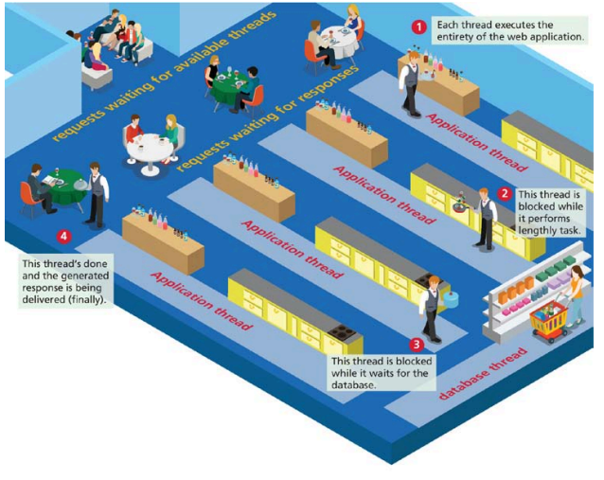
BLOCKING ARCHITECTURE
PHP on the other hand, uses blocking multi-processing multi-threaded models.
It would be as though a single person had to handle all tasks for each table.
Because of the blocking, it can sometimes cause some requests to wait longer than necessary, whereas non-blocking do not have waiting times, they instantly get feedback and can decide to retry or continue.

Slide 66
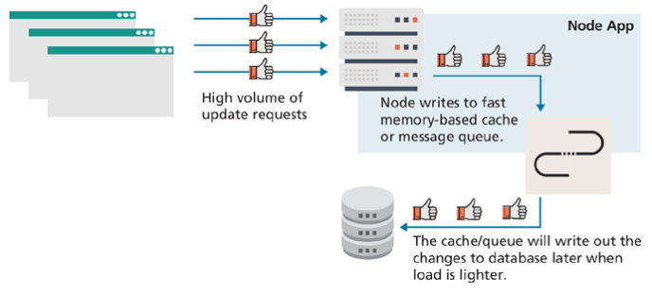
DATABASE INTERACTION
Node is often associated with data-intensive real-time applications that interact with distributed computers with noSQL databases.
For instance, if an app had to handle a lot of data writes, like liking a ‘like’ button, Node-based systems will generate a queuing system so that the database is written in sequence.

Slide 67
NODE DISADVANTAGES
Node is not ideal for traditional relational databases such as MySQL. Accessing that data is often a complex programming task.
Node is not ideal for computing heavy tasks like video processing and scientific computing.
Node can be more complex to develop and maintain than PHP or client-side JavaScript.

Slide 68
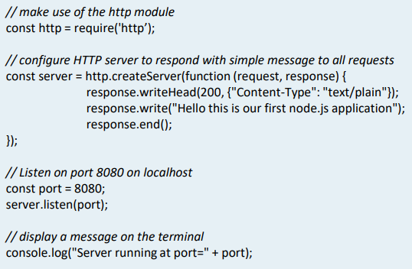
SAMPLE NODE APP CODE
To exercise a simple Node, program, install Node on your PC, and create a hello.js file.
Paste the code shown into this file.

Slide 69
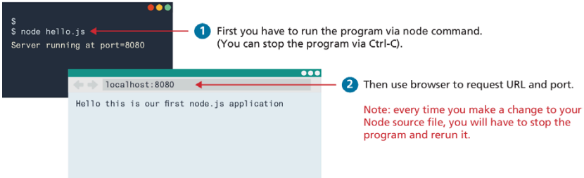
SAMPLE NODE APP RUN INSTRUCTIONS
Open a terminal window at the location of the hello.js file, and type node hello.js which will display ‘Server funning at port=8080’.
Next, open a browser, type localhost:8080 on the url, and a message will properly display.

Slide 70
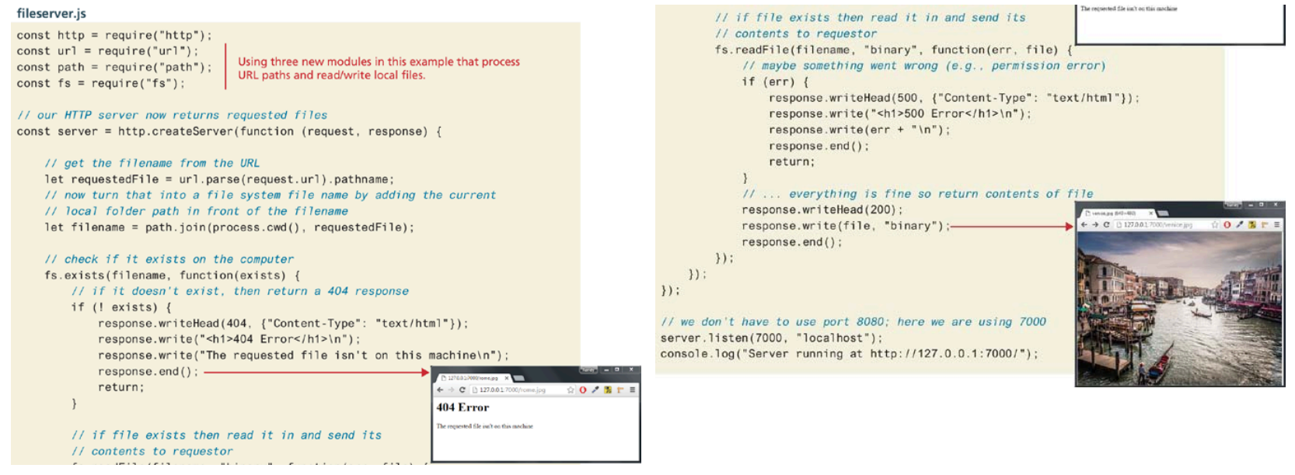
ANOTHER NODE EXAMPLE

Slide 71

ADDING EXPRESS
Express is one of the most popular frameworks that are added with Node.
It makes it easier to write handlers and routes, and adds a series of middleware steps that are essential for proper full-stack development.

Slide 72

ADDING EXPRESS

Slide 73

API WITH NODE
APIs are used to access data from a database, and Node is commonly used for that as shown with an example below.

Slide 74

ADDING ROUTES
Routes can also be added to web apps, so that params are passed through a URL when redirected to other pages of the app.

Slide 75

CRUD APIS
Although POST can be used to complete any CRUD operation, it is common to use GET for read, POST for create, PUT for update, and DELETE for delete.

Slide 76

PASSING DATA TO AN API
With a GET request, params are added on the query string, while POST requests adds the data as one of the headers.

Slide 77
OTHER

Slide 78

ENVIRONMENT VARIABLES
Environment variables are used to switch the configurations of your Node application.
For instance, an app may have a ‘test’ environment and a ‘production’ environment. Instead of changing port#s and connection strings, you can just swap the environment variable and make the switch much easier.

Slide 79

API TESTING TOOL
API developers often use third party API testing tools like Postman or Insomnia.
With these tools, you can modify an API any way you like and see what sorts of results you get. You can input different params, different content-types, different headers, …etc.

Slide 80
WEB SOCKETS
Web sockets are APIs that make 2-way communication between clients and servers. They are useful for implementing push communication such as a chat service between different client. How else could you send a message from the server to a client without sockets?
Sockets are not included as part of Node, so you have to install it separatly using npm install socket.io.
It consists of a chat-server.js and chat-client.html.

Slide 81

MESSAGE FLOW USING SOCKET.IO
The socket.io() function handles the reception of messages from clients.
A message is broadcast (or pushed) to all connected clients via the io.emit() function.

Slide 82

SERVERLESS TECHNOLOGY
Serverless technology does not mean that an app does not run on a server, it still does, but removes the need to install, configure, or update back-end environments.
It makes use of AWS or Azure to manage all deployment issues, so that full-stack developers can mainly focus on development.
They outsource server services such as reliability, scalability, and security.
Common serverless techs might include:
Database-as-a-service
Platform-as-a-service(PAAS)
Functions-as-a-service(FAAS)

Slide 83
BENEFITS OF SERVERLESS TECH
The main benefit is that it reduces complexity. There is no need to configure and support server software on your own.
By eliminating the provision servers, the serverless approach often results in lower cost, as ironic as how expensive AWS costs can be.

